Slide 1
ICT Word Processing Lesson 4: Structuring Text Content in Documents

Slide 2
Objectives – Lesson 4
7.4.1: Apply a column layout to text in a document as appropriate for the content (e.g., article, newsletter).
7.4.2: Apply simple numbered and bulleted lists in a document to make content easier to read and understand.
7.4.3: Format numbered and bulleted lists to produce a multi-level outline in a document.
7.4.4: Create a table in a word-processing document, and enter and move data in the table.
7.4.5: Convert a body of text into a table structure in a document to make content easier to read and understand.
7.4.6: Apply formatting to table rows, columns and cells in a document.

Slide 3
Lists
People today usually prefer content that is brief, easy to scan, clear and direct.
Bulleted lists – are often circles and do not specify any order or ranking
Numbered Lists – (or “ordered lists”) specify the order or sequence of list items.
Multilevel List – available in Microsoft Word for creating an outline formatted list
Lists highlight key points and make text stand out on a page. They both can be used to create an outline format of content in your document.

Slide 4
Let’s Watch the Video
How to create bullet lists, numbered lists, and multilevel lists
Click Here

Slide 5
Tables
Tables can be used in many ways to organize information to show a relationship between data or create structure for your content.
Table is arranged in rows and columns that create a grid for information.
Columns run vertically (up and down) and contain information.
Rows run horizontally (left to right) and contain information.
Cell is each rectangular box in a table — where a column and a row intersect.

Slide 6
Table Styles
Table Styles are preset designs for your table that includes border and cell coloring. Once a table is created the Table Tools tab appears with 2 options for styling your table:
Design
Shading gives you the option of selecting specific cells in your table and applying a color or shading to them.
Borders provides quick access to select where a border will appear – for just a single cell, a selection of cells or the entire table.
Layout – provides access to commands that change the basic layout of the table.

Slide 7
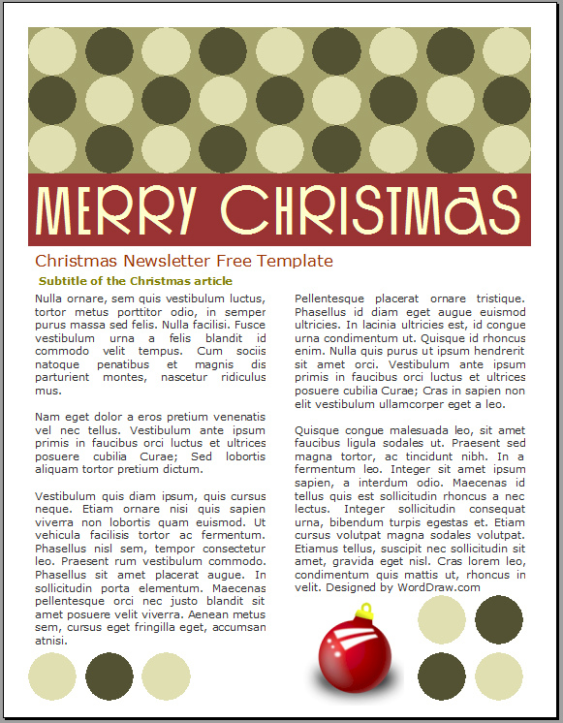
Columns
If you are looking to organize a large amount of text into a small viewing area, columns are the tool to use!
A column is a vertical division of text on a page, separated by a rule or blank space.
Most commonly used in:
Newspapers
Flyers
Newsletters

Slide 8
Let’s Watch the Video
How to create tables, manage tables, and create columns
Click Here

